Slide 1



Deep dive with no fear

Slide 2
Outline of the presentation
Terraform overview
Quick comparison with other tools
Terraform Architecture overview
From simple cases to complex adoption scenarios
Providers, Provisioners, Modules and Terraform Modules Registry
Debug, security options, sensitive managing, gotchas
HCL v2 - HashiCorp configuration language
Power of community and Tools around
Learning material, How and where to dive deeper ?
Summary, Q & A

Slide 3

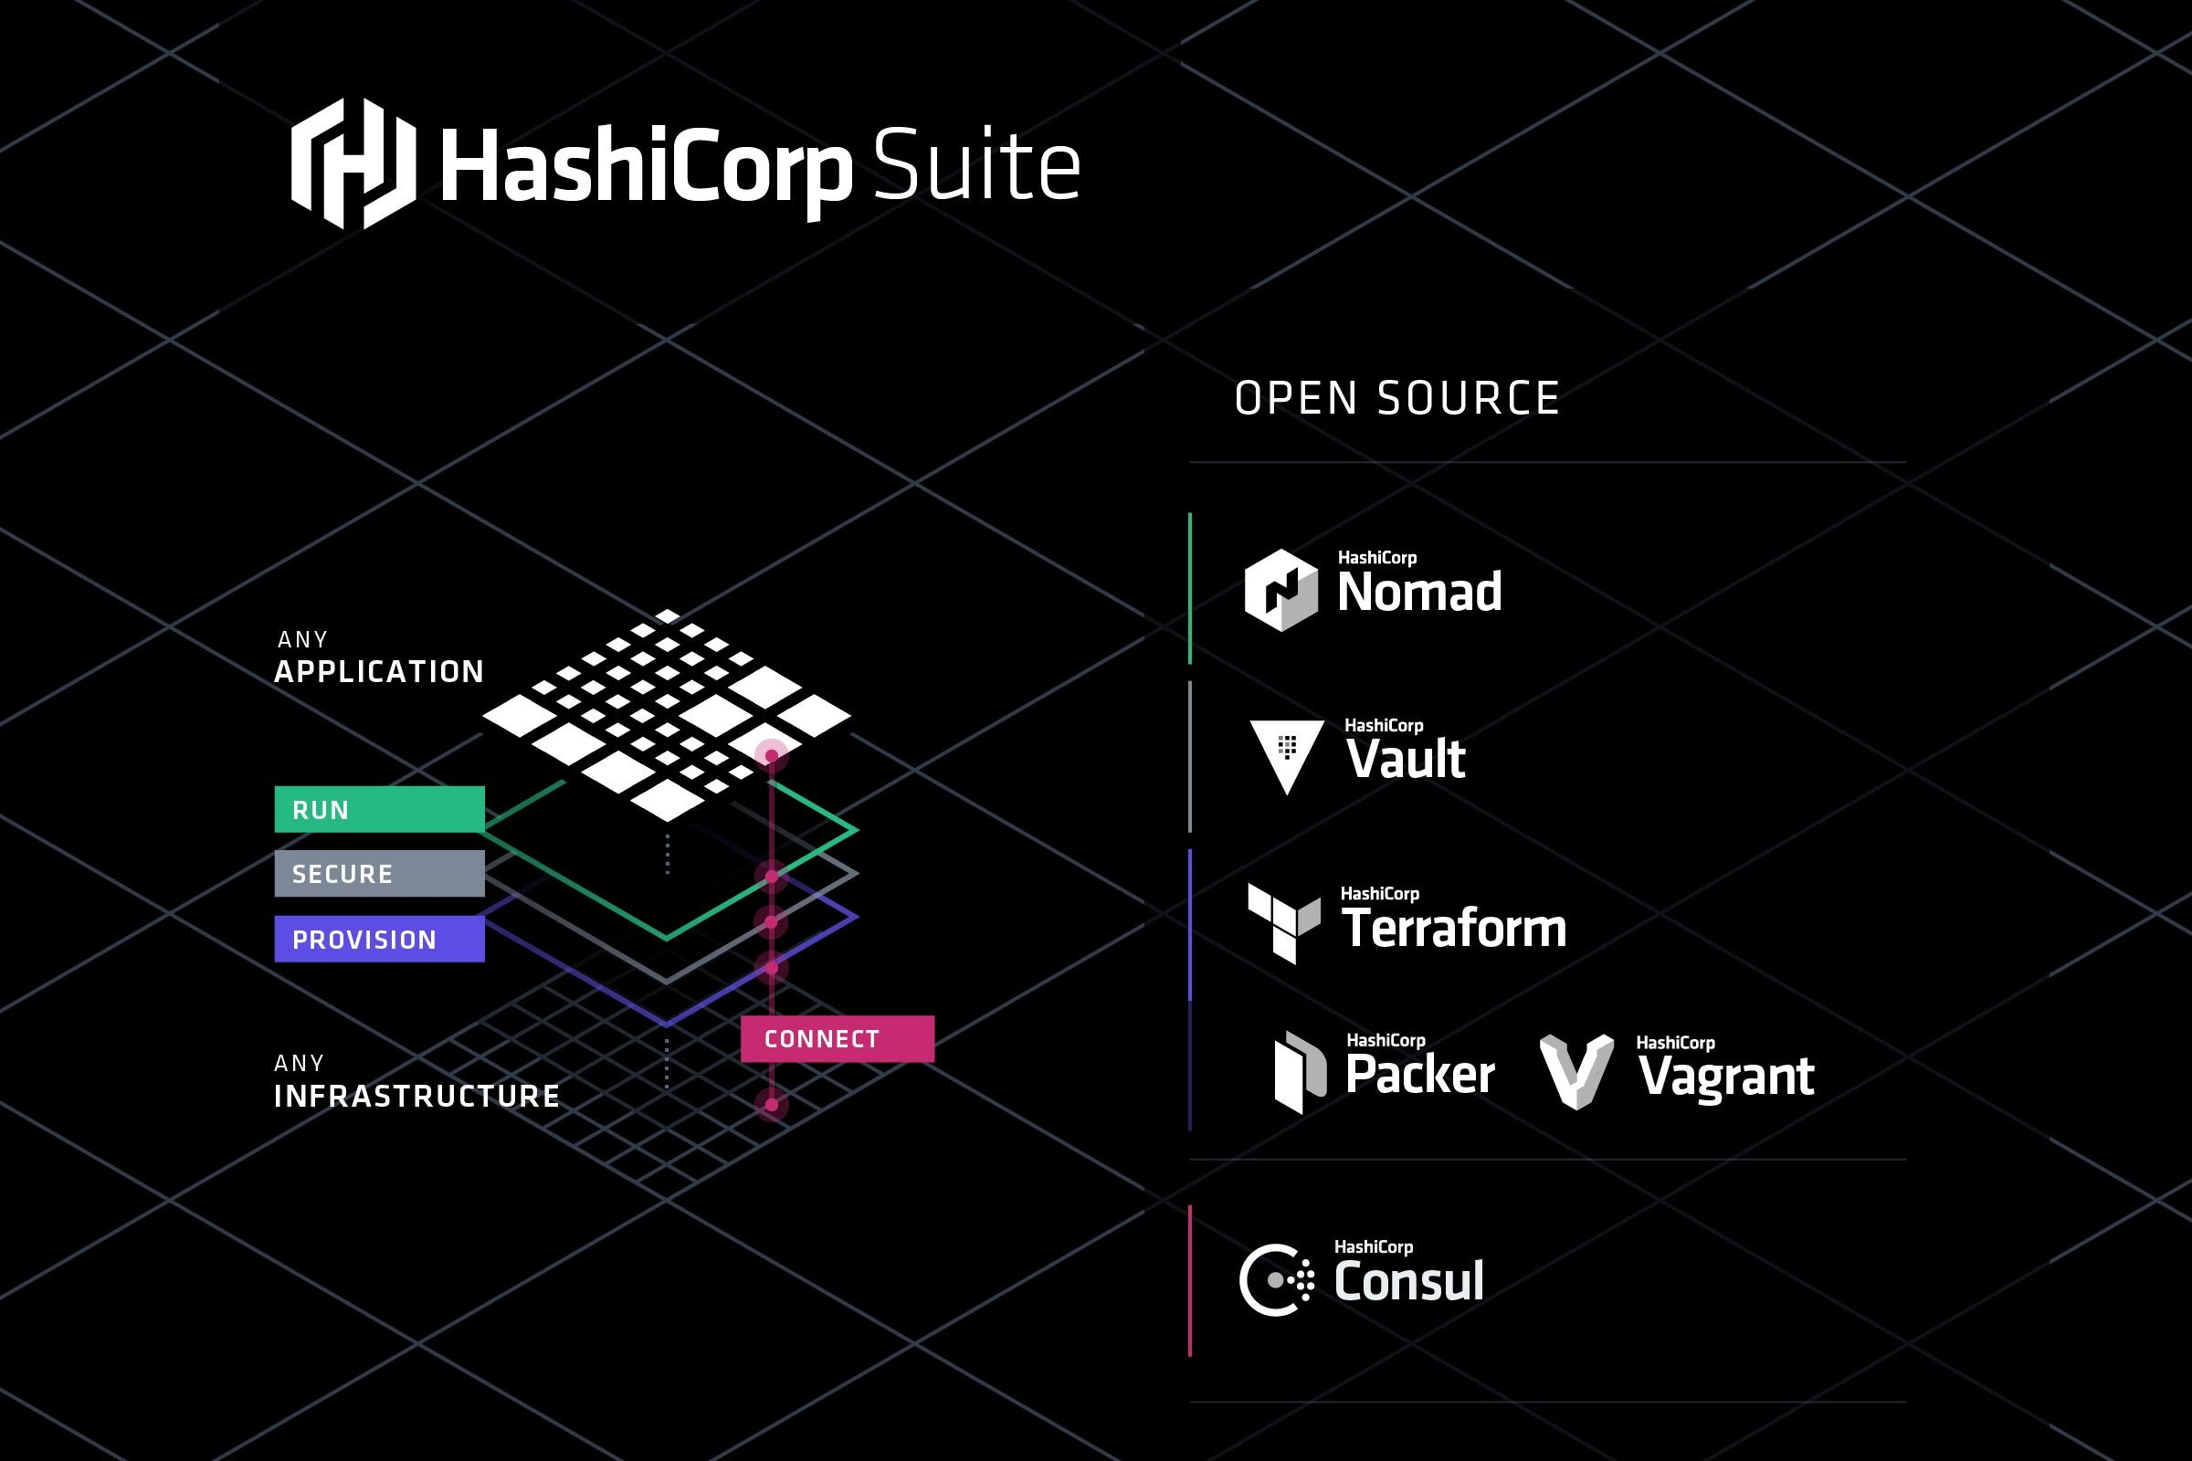

Slide 4
Terraform
Overview
A provisioning declarative tool that based on Infrastructure as a Code paradigm
Uses own syntax - HCL (Hashicorp Configuration Language)
Written in Golang
Helps to evolve you infrastructure, safely and predictably
Applies Graph Theory to IaaC
Terraform is a multipurpose composition tool:
Composes multiple tiers (SaaS/PaaS/IaaS)
A plugin-based architecture model
Open source. Backed by Hashicorp company and Hashicorp Tao (Guide/Principles/Design)

Slide 5








Other tools
Cloudformation, Heat, etc.
Ansible, Chef, Puppet, etc.
Boto, fog, apache-libcloud, etc.
Custom tooling and scripting

Slide 6
AWS Cloudformation / OpenStack Orchestration (Heat)
Comparison
AWS Locked-in
Initial release in 2011
Sources hidden behind a scene
AWS Managed Service / Free
Cloudformation Designer
Drag-and-drop interface.
Json, Yaml (since 2016)
Rollback actions for stack updates
Change sets (since 2016)
Open source
Initial release around 2012
Heat provides CloudFormation-compatible Query API for Openstack
UI: Heat Dashboard
Yaml

Slide 7
Ansible, Chef, Puppet, etc
Comparison
Created for the purpose to be a configuration management tool.
Suggestion: don’t try to mix configuration management and resource orchestration.
Different approaches:
Declarative: Puppet, Salt
Imperative: Ansible, Chef
The steep learning curve if you want to use orchestration capabilities of some of these tools.
Different languages and approaches:
Chef - Ruby
Puppet - Json-like syntax / Ruby
Ansible - Yaml

Slide 8
Boto, fog, apache-libcloud, etc.
low-level access to APIs
Some libs focused on specific cloud providers, others provide common interface for few different clouds
Inspires to create custom tooling
Custom tooling and scripting
Error-prone and tedious
Requires many human-hours
The minimum viable features
Slowness or impossibility to evolve, adopt to quickly changing environments

Slide 9
Terraform is not a cloud agnostic tool
It’s not a magic wand that gives you power over all clouds and systems.
It embraces all major Cloud Providers and provides common language to orchestrate your infrastructure resources.

Slide 10
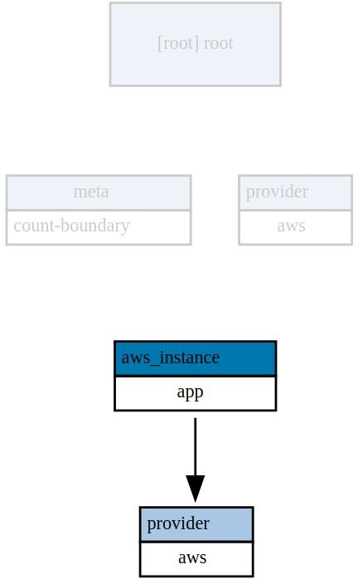
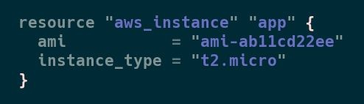
Terraform: Example (Simple resource)
example
Type
Name

Slide 11
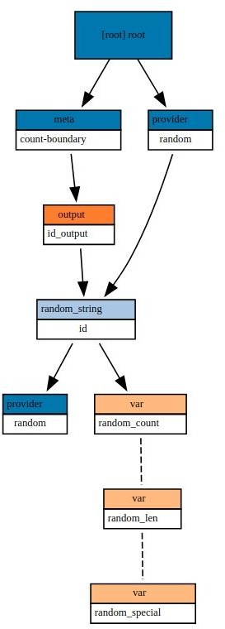
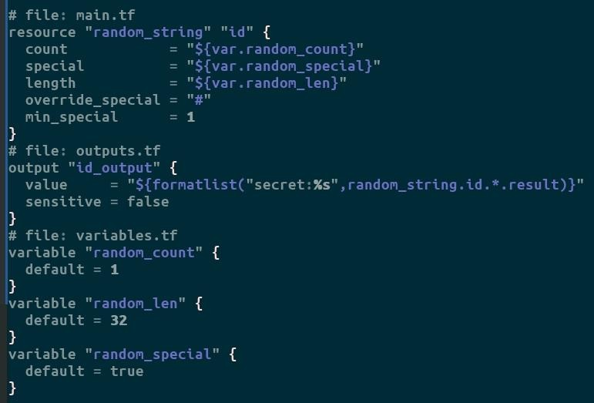
Terraform: Example (Simple local resource)
example

Slide 12

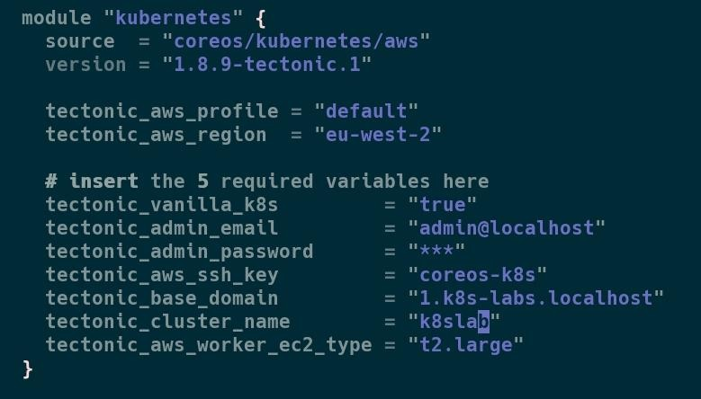


It’s just a single Module!
https://github.com/coreos/terraform-aws-kubernetes

Slide 13
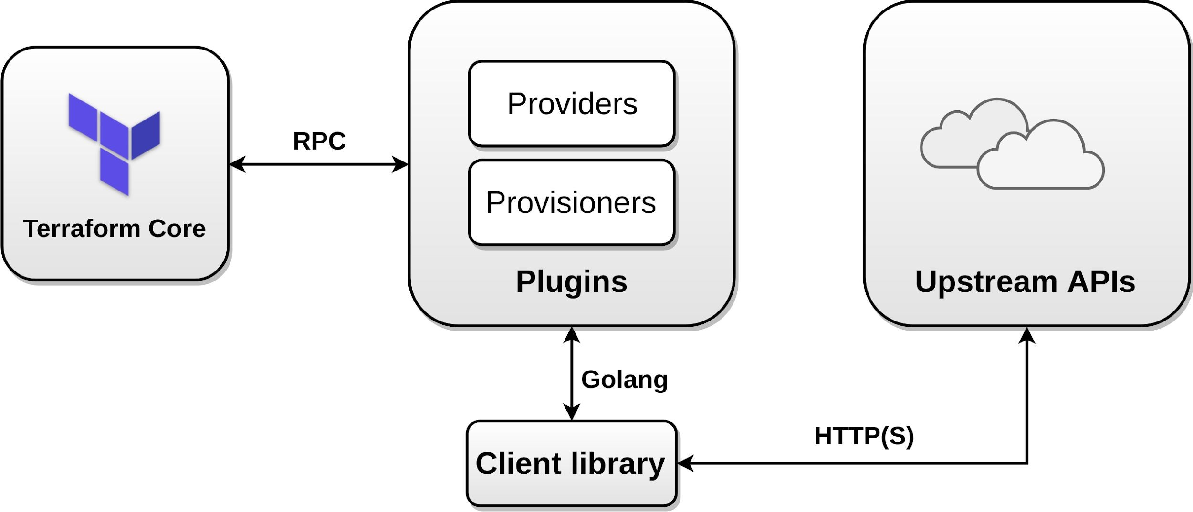
Architecture

Slide 14
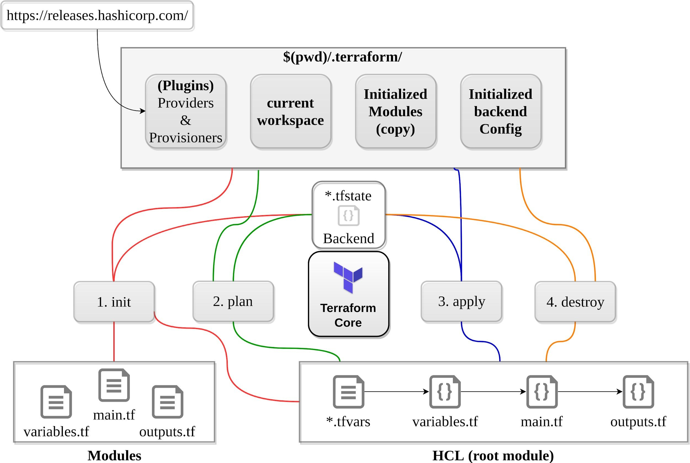
Simple workflow

Slide 15
Terraform Core: Init
example
This command will never delete your existing configuration or state.
Checkpoint → https://checkpoint.hashicorp.com/
.terraformrc → enable plugin_cache_dir, disable checkpoint
Parsing configurations, syntax check
Checking for provisioners/providers (by precedence, only once)→ “.”, terraform_bin_dir, terraform.d/plugins/linux_amd64
.terraform/plugins/linux_amd64
File lock.json contains sha-512 plugin hashes (.terraform)
Loading backend config ( if it’s available, local instead ) Backend Initialization: Storage for terraform state file.

Slide 16
Terraform Core: Plan + Apply
Starting Plugins: Provisioners/Providers
Building graph
Terraform core traverses each vertex and requests each provider using parallelism
Providers syntax check: resource validation
If backend == <nil>, use local
If “-out file.plan” provided - save to file - the file is not encrypted
Terraform Core calculates the difference between the last-known state and the current state
Presents this difference as the output of the terraform plan operation to user in their terminal

Slide 17
Terraform Core: Destroy
Measure twice, cut once
Consider -target flag
Avoid run on production
No “Retain” flag - Remove resource from state file instead
terraform destroy tries to evaluate outputs that can refer to non existing resources #18026
prevent_destroy should let you succeed #3874
You can’t destroy a single resource with count in the list

Slide 18






Terraform Backends
Locking
Workspaces (former known as environments)
Encryption at rest
Versioning
Note: Backend configuration doesn’t support interpolations.
Azure Blob
Google Cloud Storage
AWS S3

Slide 19

Terraform: Providers (Plugins)
300+ infrastructure providers
Major Cloud Partners

Slide 20
Terraform: Providers (Plugins)
Abstraction above the upstream API
Invoke only upstream APIs for the basic CRUD operations
Providers are unaware of anything related to configuration loading, graph theory, etc.
Consume an external client library ( don’t try to implement client library itself, modularize )
aws-sdk-go
azure-sdk-for-go
k8s.io/apimachinery
k8s.io/client-go
...

Slide 21



Terraform: Providers (Plugins)
Can be integrated with any API using providers framework
Note: Terraform Docs → Extending Terraform → Writing Custom Providers
OpenFaaS
OpenAPI
Generic Rest API
Stateful
Docker
Kubernetes
Nomad
Consul
Vault
Terraform :)
GitLab
GitHub
BitBucket
DNS
Palo Alto Networks
F5 BIG-IP
Template
Random
Null
External (escape hatch)
Archive
NewRelic
Datadog
PagerDuty
Digital Ocean
Fastly
OpenStack
Heroku

Slide 22

Terraform Provisioners
Run code locally or remotely on resource creation
Resource is tainted if provisioning failed. (next apply it will be re-created
You can run code on deletion. If it fails - resources are not removed
file
local-exec
remote-exec
masterless
null_resource +

Slide 23
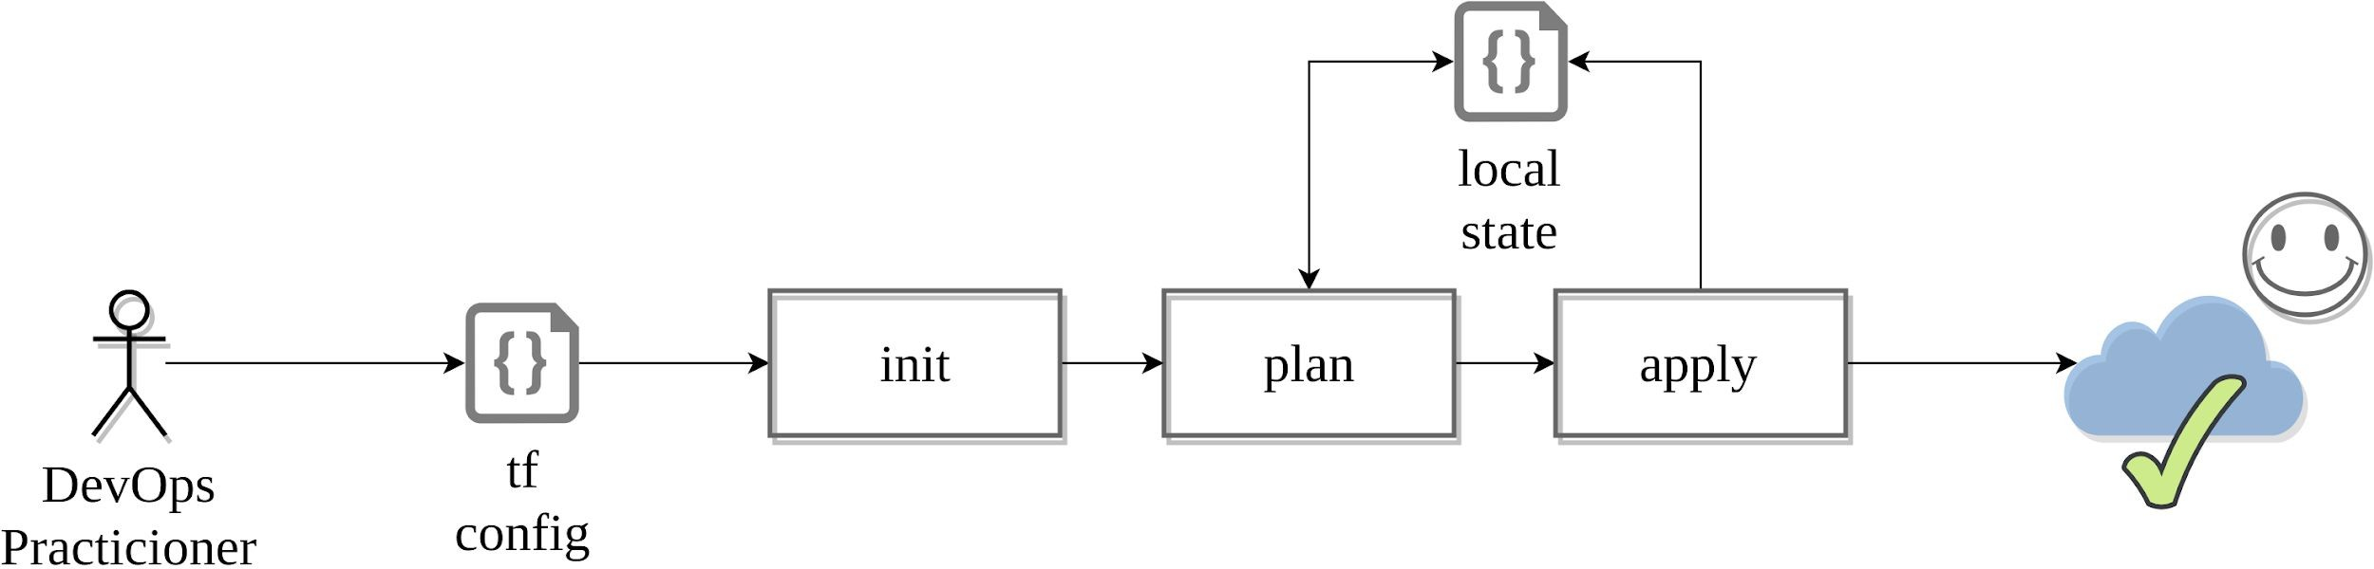
Workflow: Adoption stages
Single contributor

Slide 24
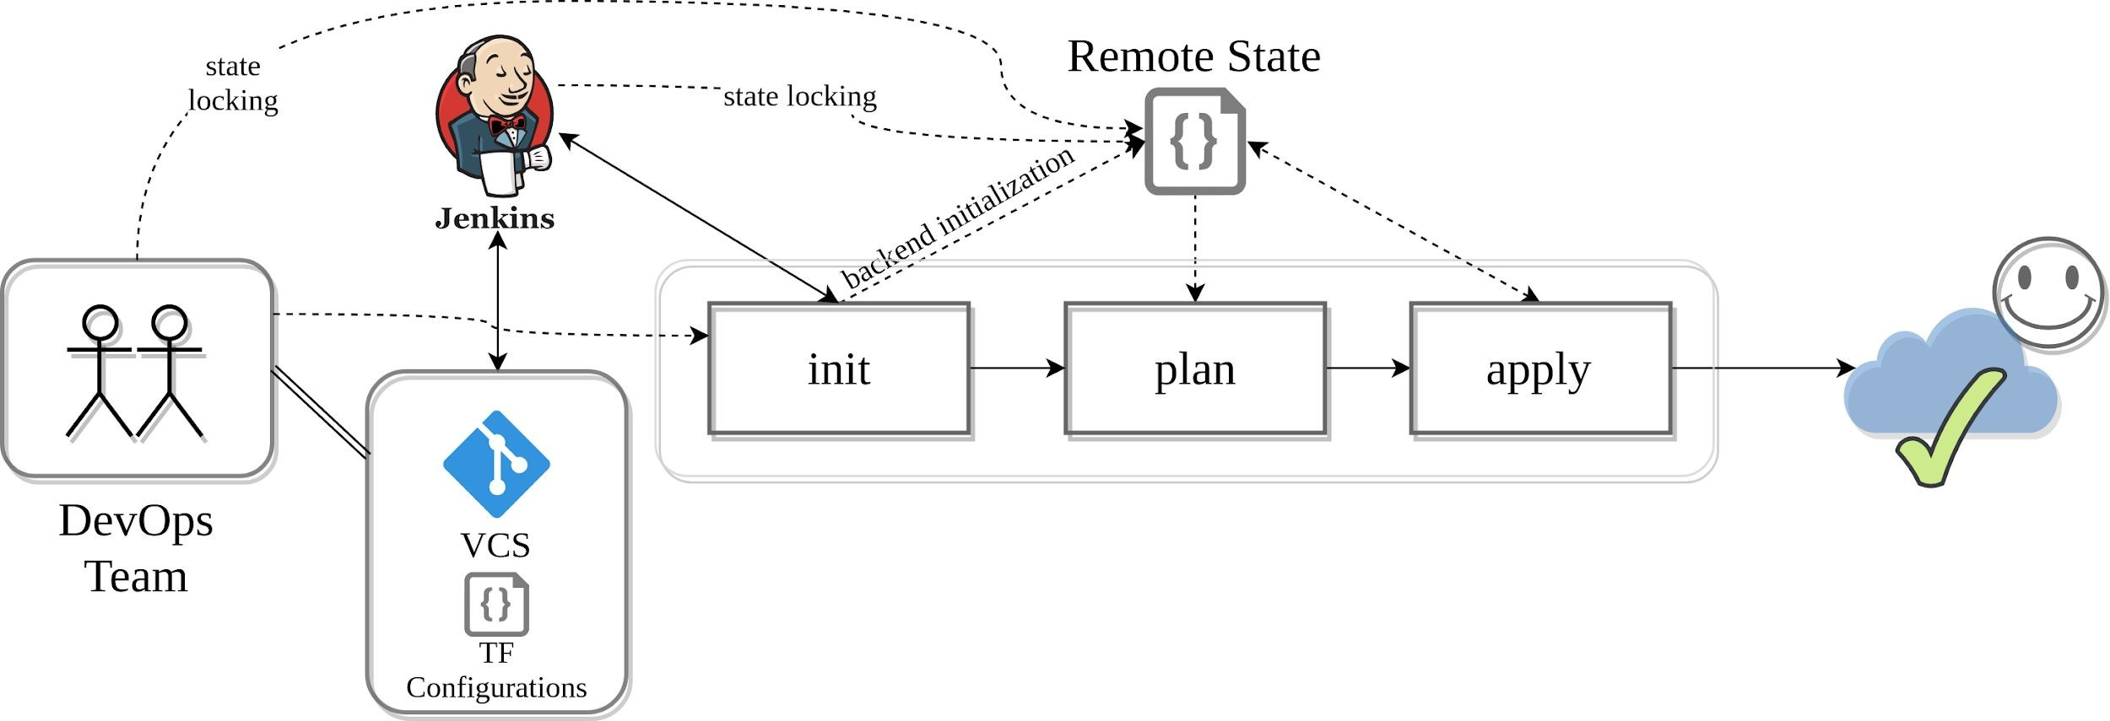
Workflow: Adoption stages
Team Collaboration

Slide 25
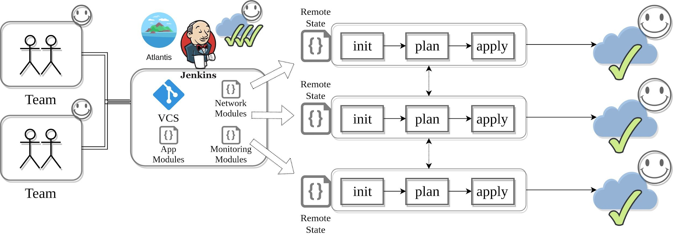
Workflow: Adoption stages
Multiple Teams

Slide 26
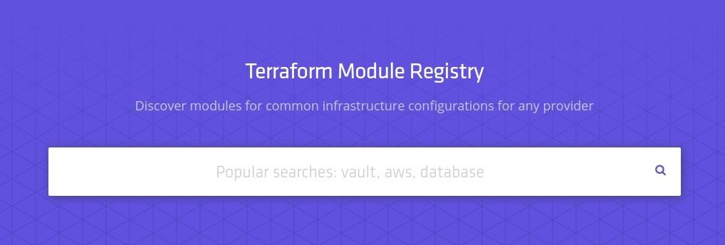
Workflow: Modules
Code reuse
Apply versioning
Use version constraints
Store code remotely
Easier testing
Encapsulation
Use and contribute to Module Registry

Slide 27

Workflow: Modules
What is the good terraform module?
Clean and flexible code
Well presented default values
Covered with tests
Examples
Documentation
Changelog
Secure
Do not overload modules with features: Terraform does cloning everything

Slide 28
Debug
TF_FORK=0
add an environment variable to prevent forking #8795
TF_LOG → TRACE, DEBUG, INFO, WARN or ERROR
TF_LOG_PATH
Found a bug? Report to the right place:
Check GitHub, it’s highly likely a known bug/”feature”
https://github.com/hashicorp/terraform - Core Issues
https://github.com/terraform-providers - Provider Plugins
Check Golang SDK’s bugs
Check Cloud provider documentation
Don’t forget to obfuscate your crash log :)
Use delve debugger to learn how Terraform core works!

Slide 29
Terraform state file
Backup your state files + use Versioning and Encryption
Do Not edit manually!
Main Keys: cat terraform.tfstate.backup | jq 'keys'
"lineage" - Unique ID, persists after initialization
"modules" - Main section
"serial" - Increment number
"terraform_version" - Implicit constraint
"version" - state format version
Use “terraform state” command
mv - to move/rename modules
rm - to safely remove resource from the state. (destroy/retain like)
pull - to observe current remote state
list & show - to write/debug modules

Slide 30
Terraform tips
Use terraform console
echo "random_string.new.result" | terraform console
Use workspaces for simple scenarios
Isolate state files and don’t use workspaces :)
To review output from terraform modules: terraform output -module=mymodule
My state is changed every time when I’m running terraform with different users! (binary files/lambda functions)
substr("${path.module}"/, length(path.cwd) + 1, -1)
ignore_changes = ["filename"]

Slide 31
Terraform: common workflow issues
Mess up with workspaces
Hard-coded values
Not following naming convention (tags)
TF can’t detect changes to computed values
Renaming modules, resources
Double references
Syntax problems
Variable “somevar” should be type map, got list
Timeouts
Permissions

Slide 32
Terraform: Sensitive information
terraform plan “-out plan-latest” - is not secured
terraform state - not secured.
Encryption on backend at rest
terraform pull - exposes sensitive
use data sources - grant only what you need
Data remote state - Not possible to expose just single or few outputs
Sensitive output
Encrypt tfvars
terraform output sensitive = true
seems ok? remote_secured = <sensitive>
terraform refresh → exposed, remote_secured = 79e6

Slide 33
Terraform: Sensitive information
How to handle secrets in state file?
Terrahelp - https://github.com/opencredo/terrahelp
Don’t store secrets :) Use:
AWS/Google Cloud/Azure Key Vault/ etc. KMS -like + user-data mechanisms
AWS System Manager Parameter store
AWS Secrets manager
Use resource Roles
If set master-password for DB service - change it after creation.
Secure state at rest using backend built-in encryption
Secure tfvars and other project/module specific information with:
pass - The password store - https://www.passwordstore.org/
git-crypt - https://github.com/AGWA/git-crypt

Slide 34
Terraform: Gotchas?
output and values don’t support count
How to output resource with count 0 (ugliest hell)
https://github.com/hashicorp/terraform/issues/16726
https://github.com/hashicorp/terraform/issues/17425
Setup caching and disable checkpoint in terraformrc
Use autocomplete and zsh
Use Constraints: it is recommended to constrain the acceptable provider versions via configuration, to ensure that new versions with breaking changes will not be automatically installed by terraform init in future
Use constraints for everything !

Slide 35
Terraform: Gotchas?
Do not overuse “Depends_on”
Use implicit dependencies via interpolation expressions
Explicit dependencies are required rarely, often with null-resources/custom providers/etc.
Do not overuse terraform import (at least for now - 0.11/0.12)
better is to create resources from scratch
it doesn’t generate code for you
Share some parts of infrastructure using “data terraform_remote_state"
Consider to use data resources for the same purpose
Do not overuse “workspaces” (former environments)
they don’t have straightforward workflow
you can’t use different backends
Enjoy clean code! Automate it: terraform fmt, pre-commit-terraform https://github.com/antonbabenko/pre-commit-terraform

Slide 36
Terraform: Gotchas?
Data sources can lock tfstate
Overrides: *override.tf - can be used to temporarily adjust your infra in CI
Modules don’t have count, but you can have variable and count internally in the module.
Terraform extensively uses TempFile() to store temp data during the run-time:
/tmp/terraform-log#########
/tmp/state-*
Prevent_Destroy behaviour:
set prevent_destroy - works? Try to remove resource… (don’t…) Use “terraform state rm” type.resource.name

Slide 37
Terraform challenges and how can you help?
More Providers: Networking, New Cloud Service Providers, On-premise systems
Improving quality of current providers, new features, testing.
Modules
Importing resources
New provisioners support
Storing sensitive information
Splitting monoliths → More tools

Slide 38
Long winding road to 0.12
0.11.x → 0.12.x
Modules attributes:
"providers" - provider inheritance for modules
"version" - constraints
Interactive “terraform apply”
Interpolation improvements, new features:
timeadd
rsadecrypt
Myriad bug fixes
Improvements:
Backends
CLI
Provisioners
Many issues are on-hold till 0.12 version is released

Slide 39
Terraform: 0.12 New Features
examples
Better error messages
Reliable JSON Syntax - 1:1 mapping to Json
Comments in JSON
Template Syntax Improvements
Rich and Complex Value Types
Return Module resources as Object values
Maps of Maps? It’s possible!
Conditionally Omitted Arguments
Conditional Operator Improvements
Splat Operator
For and For-Each - Finally! - For nested blocks!

Slide 40

Terraform issues:
Support count in resource fields #7034 (For / For-Each → 0.12)
depends_on cannot be used in a module #10462
Proposal: Module-aware explicit dependencies #17101 (freezed, ~ 0.12+ )
Allow using lists and maps with conditionals #12453 (Conditionals → 0.12)
Support the count parameter for modules #953 (Breaking change,freezed)
Support for nested maps in variables #2114 (Complex types → 0.12)
Data sources should allow empty results without failing #16380
allow `-target` to accept globs #2182 ( Thumb up! )
Storing sensitive values in state files #516 ( Vault integration ? Thumbs up ! )

Slide 41
Helper Tools around:
Reformat the output of terraform plan to be easier to read and understand.
https://github.com/coinbase/terraform-landscape
Export existing AWS resources to Terraform style (tf, tfstate)
https://github.com/dtan4/terraforming
Terraform version manager https://github.com/Zordrak/tfenv
Generate documentation from Terraform modules https://github.com/segmentio/terraform-docs
Detect errors that can not be detected by terraform plan https://github.com/wata727/tflint

Slide 42
Terraform: Interactive Graph visualizations
Blast Radius
https://28mm.github.io/blast-radius-docs/ https://github.com/28mm/blast-radius
Author Licence
: Patrick McMurchie
: MIT

